Slide 1

Presentation
Course Code: CSE-4302
Course Title : Computer Graphics and Pattern Recognition Sessional.

Slide 2
Topic: Pattern Recognition and Neural Network-Driven Roller Track Analysis via 5G Network
Submitted By
Submitted To
1. Name: Sumaiya Ahmed Susmi ID:2020105810
2. Name: Isfat Ara Hasan Ema ID:20201112010
3. Name: Fatema Zahan Shayla ID:20201159010
Department of Computer Science and Engineering
Name: M. Raihan
Assistant Professor
Department of Computer Science and Engineering
Department of Computer Science and Engineering
North Western University, Khulna.

Slide 3
1. Introduction
This paper introduces a system for detecting falls in roller skating competitions, employing an Automatic Movement Identifier (AMI) embedded in athletes' bodies. The AMI utilizes a Back-Propagation (BP) neural network for data training, analyzing roller tracks internally through pattern recognition. To ensure stability and minimize transmission delay, the paper advocates for a 5G-enabled network for communication between athletes and remote referees. Experimental results showcase a remarkable 100% prediction accuracy, underscoring the system's efficacy in preventing falls. The paper concludes with an overview of the network architecture and its significant contributions.
2. Network Architecture
This study outlines a network architecture centered around roller athletes and remote video monitor referees. The key element is the Automatic Movement Identifier (AMI), integrated into roller athletes, comprising pattern recognition and Back-Propagation (BP) neural network modules. The AMI processes roller tracks data and transmits results in two ways: direct communication to athletes for competition termination or to referees for posture adjustment. Emergency situations prompt immediate athlete communication, while the 5G-enabled network ensures swift and stable data transmission between AMI and referees.

Slide 4
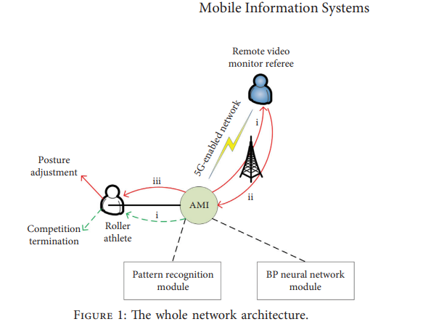

Slide 5
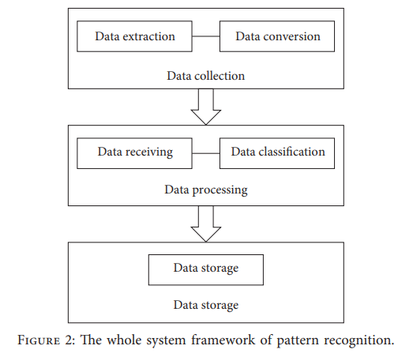
3. Pattern Recognition
This section details the pattern recognition process within the Automatic Movement Identifier (AMI) system for roller skating. Implemented on a field-programmable gate array (FPGA), the pattern recognition involves data collection, processing, and storage. The feature vector determination employs the law of large numbers and Chebyshev-based coagulation equation for data classification. Membership degree function computation utilizes the Cauchy distribution as a reference, determining the maximum membership degree for data storage in AMI. The pseudocode outlines the process, involving clock collection, initialization, address processing, and data storage. Overall, the section provides a comprehensive overview of the pattern recognition framework essential for effective roller track analysis.

Slide 6
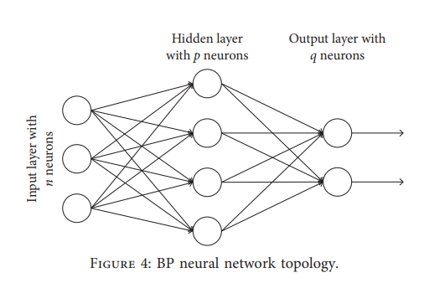
4. BP Neural Network
This section discusses the application of the Back-Propagation (BP) neural network in analyzing roller tracks stored in the Automatic Movement Identifier (AMI) system. The BP neural network consists of input, hidden, and output layers, with emphasis on weight adjustment through the learning rate (η) and error function (E). Recognizing the limitations of traditional BP networks, the paper introduces enhancements, including momentum attachment and dynamic learning rate optimization.
Input the roller tracks data
Build BP neural network according to Figure 4
Add momentum factor β and self-learning rate α into BP neural network
Compute the error function according to equation
Modify the weight adjustment
Check whether the number of training satisfies the given I (7) Output the analyzed results on roller tracks
(8) Send the results to the roller athlete or the monitor referee according to the real emergency

Slide 7
5. Performance Evaluation
The PRNN roller track analysis method is evaluated using NS3, simulating 1500 roller competitions due to the absence of an open dataset. A baseline method, PRWI, without the improved BP neural network, is considered. Four 5G wireless base stations facilitate efficient data communication. The crucial parameters α and β for the improved BP neural network are assessed, with α=0.7 and β=0.3 identified as optimal for minimal standard deviation. The evaluation explores different phases of standard deviation change with varying α and β values.
6. Conclusions
This paper employs pattern recognition and BP neural networks for roller track analysis, ensuring stable transmission with 5G. Pattern recognition in AMI on FPGA and enhanced BP neural network via momentum attachment and dynamic learning rates are featured. NS3 simulations confirm effective fall prevention for roller athletes, acknowledging limitations such as lacking AMI system implementation, reliance on NS3 without test-bed verification, and overlooking posture variety. Future efforts aim to address these constraints.

Slide 8
Thank You
The End

